Slide 1
Boyer-Moore
Pattern Matching

Slide 2
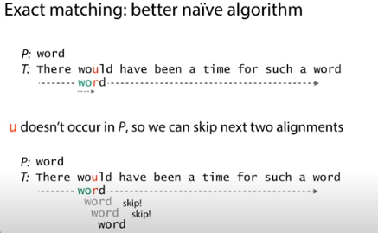

Slide 3
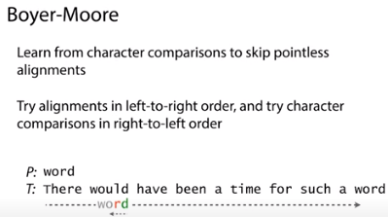

Slide 4
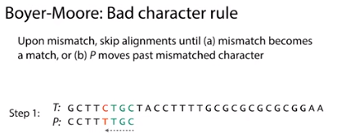

Slide 5
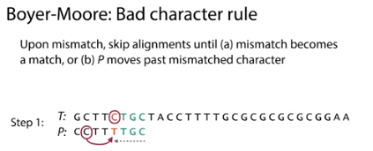

Slide 6
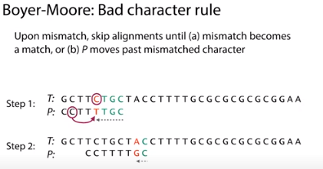

Slide 7
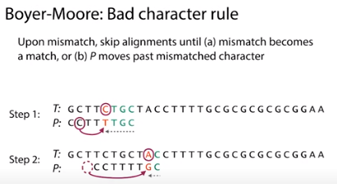

Slide 8
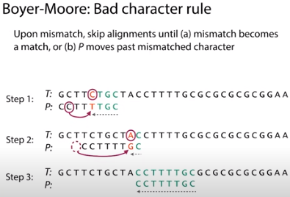

Slide 9
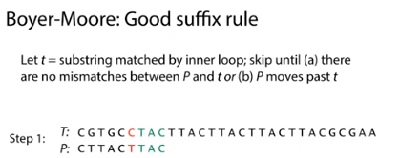

Slide 10
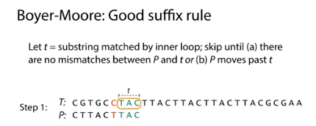

Slide 11
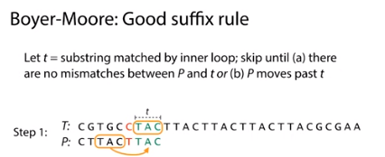

Slide 12
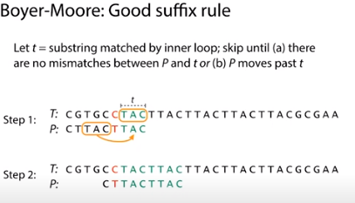

Slide 13
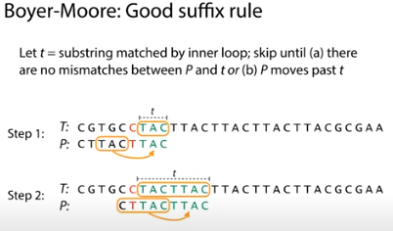

Slide 14
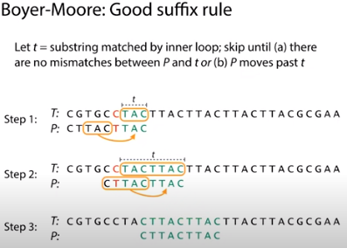

Slide 15
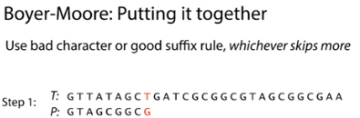

Slide 16
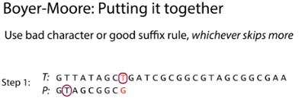

Slide 17
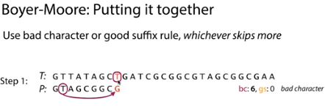

Slide 18
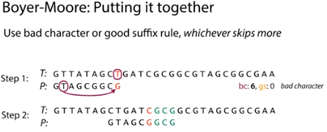

Slide 19
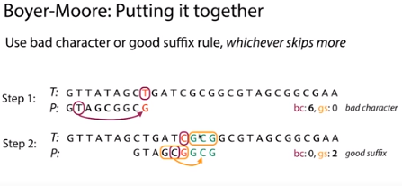

Slide 20
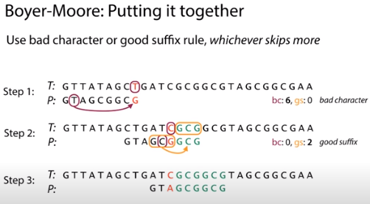

Slide 21
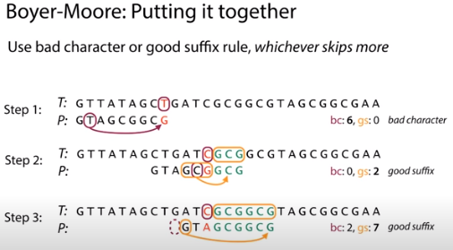

Slide 22
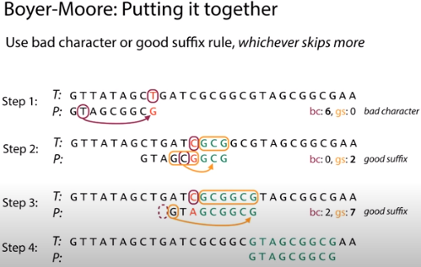

Slide 23
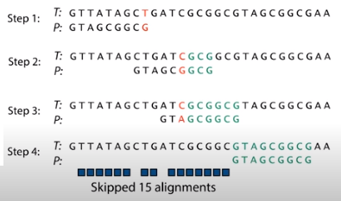

Slide 24
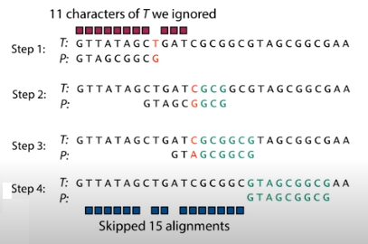

Slide 25
Pattern Matching Algorithms
Boyer-Moore Algorithm (contd.)
The following steps describe the basic Boyer-Moore algorithm at a high level:
Align the target and text on the left.
Repeat until the target’s last character is aligned beyond the end of the text:
Compare the characters in the target with the corresponding characters in the text, starting from the end of the target and moving backwards toward the beginning.
If all the characters match, you’ve found a match.
Suppose character X in the text doesn’t match the corresponding character in the target. Slide the target to the right until the X aligns with the next character with the same value X in the target to the left of the current position. If no such character X exists to the left of the position in the target, slide the target to the right by its full length.

Slide 26
Time Complexity
Worst-case performance Θ(m) preprocessing + O(mn) matching
Best-case performance Θ(m) preprocessing + Ω(n/m) matching
When the pattern does occur in the text, running time of the original algorithm is O(nm) in the worst case

